Slide 1
Science and Values in ICRP Publication 111:
Experience from Fukushima
Jacques Lochard
Chair of ICRP Committee 4
International Academic Conference on
Radiation Health Risk Management in Fukushima
25 - 27 February 2013
Fukushima, Japan

Slide 2
Content
Introductory remarks
The 2007 Recommendations of ICRP
Publication ICRP 111
  Transition from emergency to existing exposure situation
  Living in contaminated areas
  Self-help protection actions
  Management of foodstuffs
Concluding remarks
2

Slide 3
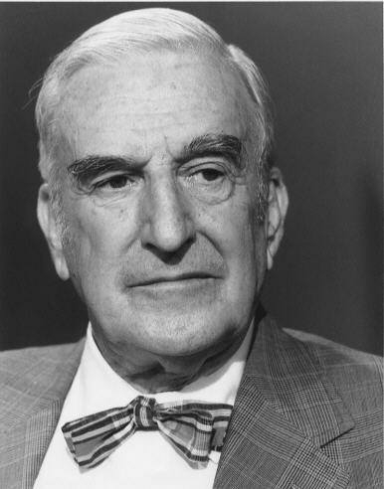
Science and values in radiological protection : a long tradition
"Radiation protection is not
only a matter for science. It is
a problem of philosophy, and
morality, and the utmost
wisdom.”
Lauriston S. Taylor (1902 – 2004)
The Philosophy Underlying
Radiation Protection
Am. J. Roent. Vol. 77, N° 5,
914-919, 1957
From address on 7 Nov. 1956
3

Slide 4
The three pillars of the system of radiological protection
Science
Values
System
of
Radiological Protection
Experience
4

Slide 5
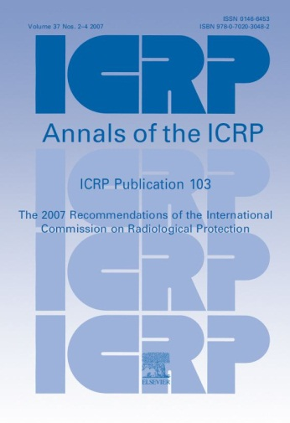
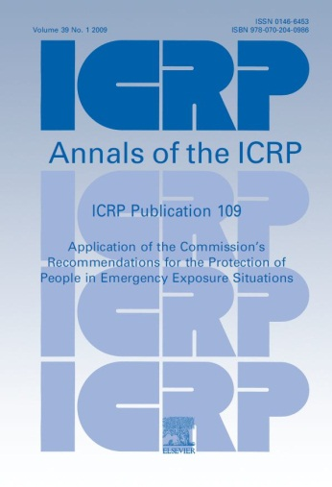
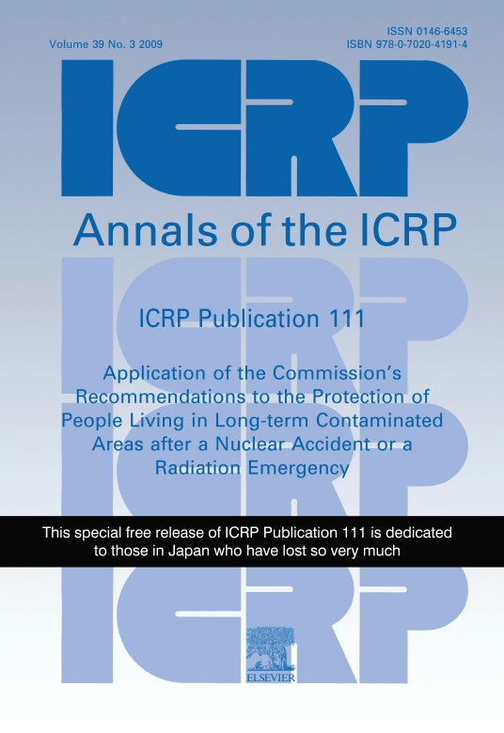
Relevant ICRP Publications
Publication 103
Fundamental
Recommendations
Publication 109
Emergency
Situations
Publication 111
Post-Accident
Recovery
5

Slide 6
Exposure situations
The Recommendations in Publication 103 organize radiological protection according to 3 types of exposure situations: existing, planned and emergency exposure situations
An exposure situation is a process including a natural or man-made radiation source, the transfer of the radiation through various pathways and the exposure of individuals
“Protection can be achieved by taking action at the source, or at points in the exposure pathways, and occasionally by modifying the location or characteristics of the exposed individuals” (ICRP 103, § 169)
Exposed
individuals
Source
Pathways
6
Notes:
04/03/13
6

Slide 7
The three types of exposure situations
Existing exposure situations : when exposures result from sources that already exist when decisions to control them are taken. Characterization of exposures is a prerequisite to their control
Planned exposure situations : when exposures result from the deliberate introduction and operation of sources. Exposures can be anticipated and fully controlled
Emergency exposure situations : when exposures result from the loss of control of a planned exposure situation, or the sudden irruption of an uncontrolled source (malicious act). These situations require urgent and timely actions in order to prevent exposures to occur or to mitigate them
  The Commission defines long term exposures resulting
  from a nuclear accident as an existing exposure situation
7
Notes:
04/03/13
7

Slide 8
The objective of protection
The Commission’s system of radiological protection aims…to manage and control exposures to ionizing radiation so that deterministic effects are prevented, and the risks of stochastic effects are reduced to the extent reasonably achievable (ICRP 103, § 29)
The primary objective is to to maintain exposure below 100 mSv : “At doses higher than 100 mSv, there is an increased likelihood of deterministic effects and a significant risk of cancer” (ICRP 103, § 236)
    The Commission provides a dose scale (related to the tolerability of risk) with three bands in order to select the individual dose restrictions (dose constraints and reference levels) to be applied in the optimisation process to reduce and maintain exposure as low as reasonably achievable taking into account economic and societal factors (Prudent attitude)
8

Slide 9
Reference levels to manage a nuclear accident
  For the protection of the public in case of a nuclear accident with potential long term consequences the Commission is recommending to select reference levels for implementing the optimisation principle:
      In the 20–100 mSv/year band for the emergency exposure situation
      In the lower part of the 1–20 mSv/year band with the long term objective to reduce and maintain exposures below 1 mSv/year for the existing exposure situation (ICRP 111, § 50)
  Authorities may select values of reference levels depending
  on the scale of the accident and the local circumstances
9

Slide 10
Transition from the emergency to the existing exposure situation after an accident (ICRP 111, § 7 to 9)
  Characterisation of the exposure situation is a prerequisite to take control of the exposures. It may take months (even years) and is part of the urgent actions to be implemented in the emergency situation
  This process can be considered complete when one has gained a fairly good knowledge on where, when, and how exposure are received in the affected area
  The characterization of the exposure situation allows :
    Authorities to decide whether those who wish may remain in the affected areas, but also if the evacuees can return and if permanent relocation is necessary in some places
    The affected people to decide to leave, to stay or to return
10

Slide 11
Transition from the emergency to the existing exposure situation after an accident
  The transition from the emergency to the existing exposure situation is based on a decision taken by authorities when they have enough information to consider that the exposures can be reasonably controlled and that decent respectable lifestyles and livelihoods can be maintained in the affected areas
  The Commission does not recommend any particular radiation protection criteria. If any is selected, it must be consistent with the guidance concerning the management for existing exposure situations i.e in the lower part of the 1 to 20 mSv /year band
11

Slide 12
Transition from the emergency to the existing exposure situation after an accident
The decision must be taken by the authorities on a case by case basis taking into account the prevailing circumstances i.e. :
  The current residual levels of exposure in the affected areas and the foreseen levels given the implemented remediation actions
  The conditions and means to maintain sustainable living conditions of the affected population in these areas
The transition is characterized by a change in management from predominantly centralized decisions to more decentralized strategies favouring individual self-help protection actions supported by an adequate infrastructure established by authorities (ICRP 109, § 118)
Different affected areas may undergo this transition at different times
12

Slide 13
Transition from the emergency to the existing exposure situation after an accident
Emergency Exposure Situation
Reference level in the 20-100 mSv/year range
Protection actions to reduce and maintain exposure ALARA driven by urgency
Characterization of the radiological situation
Setting-up radiation monitoring, health surveillance and foodstuffs management
Existing Exposure Situation
Reference level in the lower part of the 1-20 mSv/year range with long term goal of less than 1 mSv/year
Protection actions to reduce and maintain exposure ALARA driven by the improvement of living conditions
Development of self-help protection and radiation protection culture
Decision by
authorities
13

Slide 14
Lessons from Fukushima
Japanese authorities adopted a series of decisions during the March-April 2011 period to manage the emergency exposure situations, successively: evacuation, sheltering, iodine distribution, drinking water and food restrictions (March), and temporary relocation (April)
The characterisation of the exposure situation allowed progressively to lift some restrictions, to establish a decontamination programme, to put in place radiation monitoring and health surveillance, and to finally rearrange the areas resulting from the emergency phase (restricted areas, ”difficult to return areas”,…, announced in December 2011 and decided in March 2012)
Following the criteria in ICRP Publication 111, this last date can be considered as the effective beginning of the existing exposure situation
14

Slide 15
Living in contaminated areas (ICRP 111, § 16 to 23)
Living in a contaminated environment is a complex situation generating a lot of questions and concerns and a feeling of loss of control on daily life and exclusion among the population
Each individual is permanently confronted to the question: “Should I stay or leave the area?” “Should I return or not?”
The attitudes of the affected population range from resignation to willingness to improve the situation
Exposures are driven by individual behaviours and the socio-economic situation in the affected areas and result in a large individual dose distribution
Mean doses for managing protection is not appropriate. For considerations of prudence against the risk, but also equity, priority should be given to reducing doses of the most exposed individuals
15

Slide 16
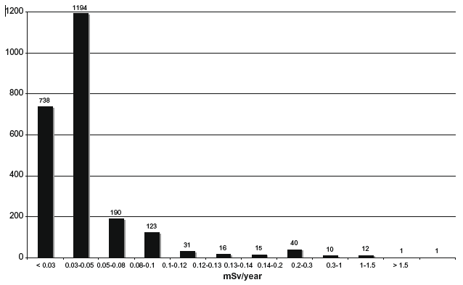
Typical dose distribution from caesium intake of children in the contaminated area around Chernobyl
20 years after the accident
Reference level: 1 mSv
16

Slide 17
Distribution of individual external dose
in Fukushima affected areas
Cumulative effective dose for four months from 11 March to 11 July 2011
9,747 residents of Kawamata, Namie and Iitate
91,6% of residents less than 5 mSv and 99.3% less than 10 mSv
71 residents beyond 10 mSv (Max. 23 mSv)
Number of people
(Reported on February 20, 2012, http://wwwcms.pref.fukushima.jp/)
17

Slide 18
Living in contaminated areas
  To be effective protection strategies should include actions implemented by authorities at the national and local levels and by the affected population itself = self help protection actions
  To participate to their own protection, inhabitants from the affected areas must understand:
Where, when and how they are exposed?
What can they do to protect themselves ?
  to regain control on the situation and to become actors of their own protection = practical radiation protection culture
  It is the responsibility of authorities to establish programmes for continuous radiation monitoring, health surveillance, and information and education of the population to favour the engagement of the population in its own protection
18

Slide 19
Living in contaminated areas
  The dissemination within all segments of the population of a “practical radiation protection culture” is a powerful way:
    to involve directly the local professionals and affected population in the day to day rehabilitation of living conditions and to empower them,
    and consequently to break the trend of loss of control and exclusion
  When people understand :
    Where, when and how they are exposed?
    What can they do to protect themselves ?
  they spontaneously engage themselves in their own protection and they progressively take control of the situation they face every day
19

Slide 20
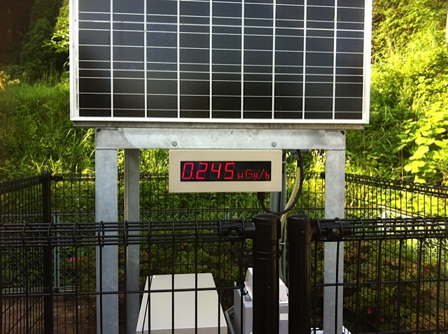
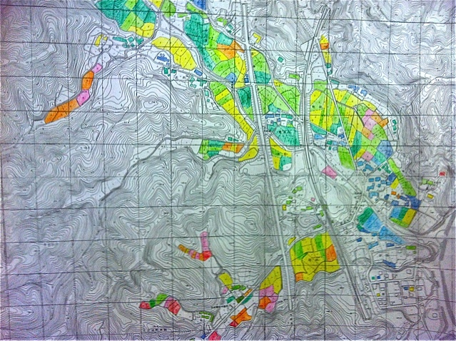
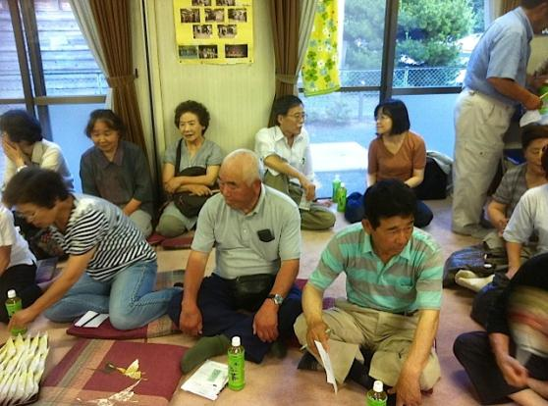
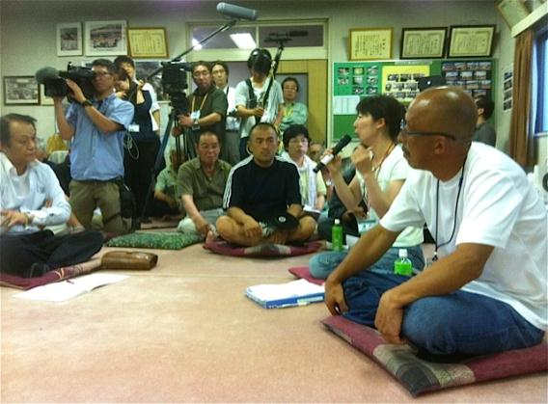
The engagement of the Suetsugi community
20
Notes:
20

Slide 21
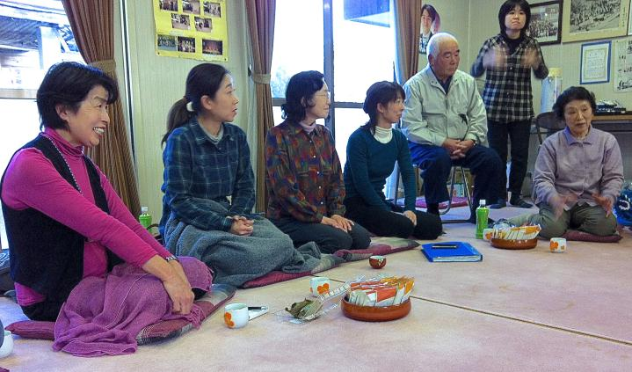
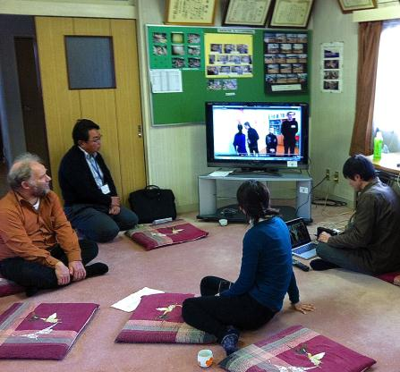
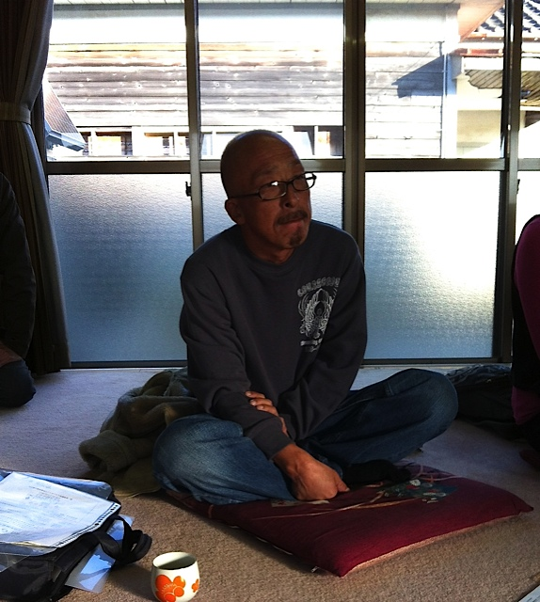
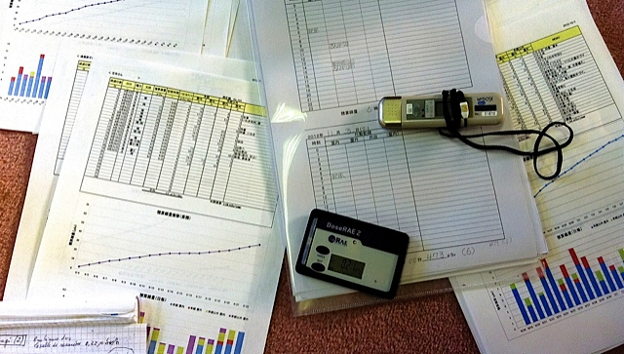
The engagement of the Suetsugi community
21
Notes:
21

Slide 22
The management of contaminated foodstuffs
(ICRP 111, § 82,83)
For management of the radiological quality of foodstuffs in a country with a contaminated territory, relevant stakeholders (authorities, farmers’ unions, food industry, food distribution, consumer non-governmental organisations, etc.) and representatives of the general population should be involved in deciding whether individual preferences of the consumers should outweigh the need to maintain agricultural production, rehabilitation of rural areas, and a decent living for the affected local community. A thorough debate at national level is necessary to achieve a certain degree of solidarity within the country (ICRP 111, § 84).
The restoration and maintenance of consumer confidence is of prime importance in the management of contaminated foodstuffs. Traceability of food is an important factor in consumer preferences. The Commission views the mention of the region of origin on foodstuff labels as a sufficient indicator for marketing purposes (ICRP 111, § 90).
22

Slide 23
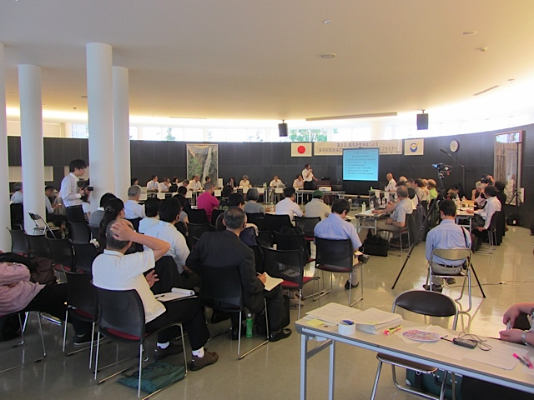
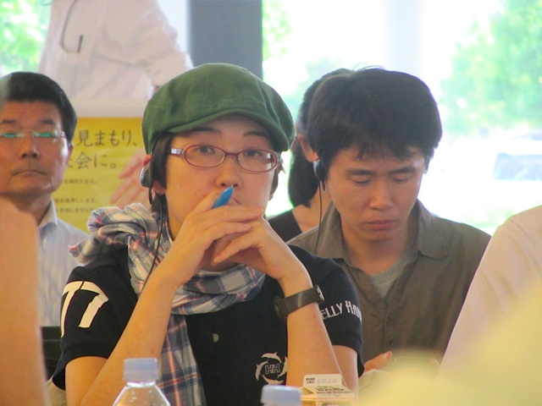
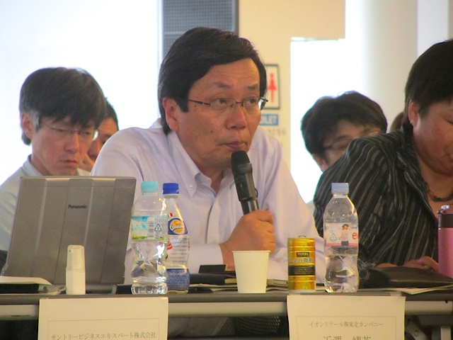
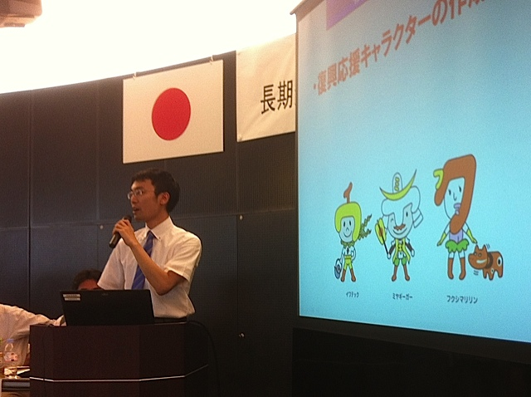
A dialogue between producers, distributors
and consumers (July 2012)
23

Slide 24
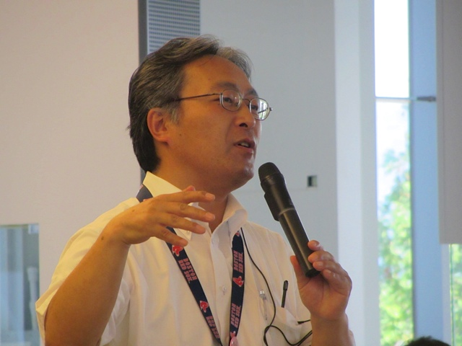
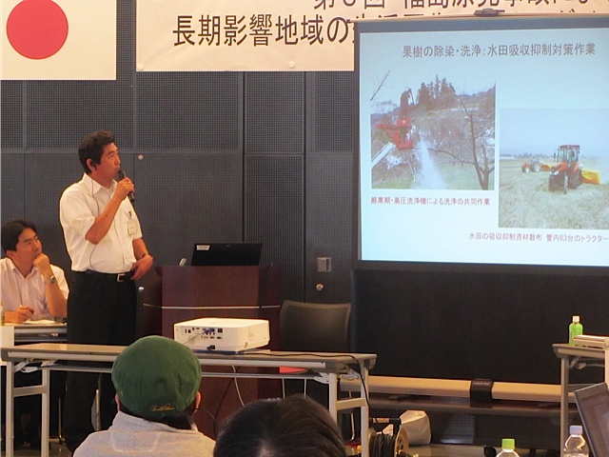
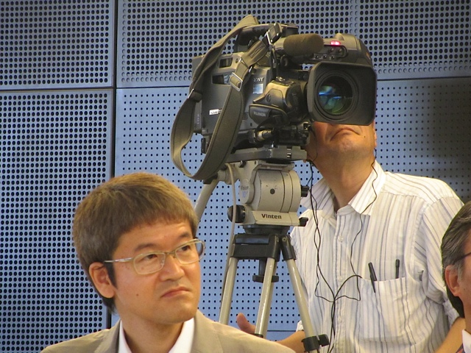
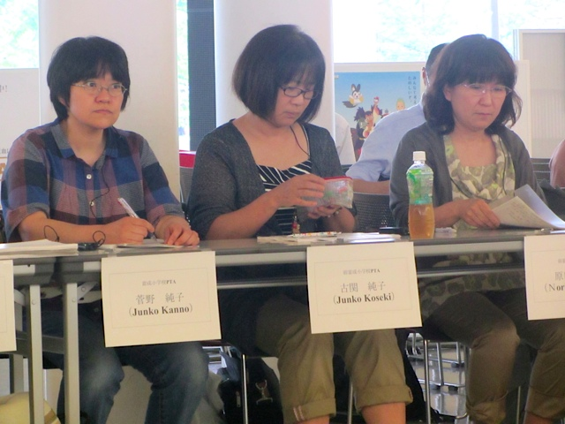
A dialogue between producers, distributors and consumers (July 2012)
24

Slide 25
Recommendations of the dialogue
  Continue to develop monitoring strategies and management procedures to allow farmers to control the radiological quality of their products in order to regain confidence of consumers
  Create a forum for a permanent dialogue between all concerned parties (producers, distributers and consumers) on the issue of foodstuff
  Continue efforts to monitor individual internal and external exposures, and to provide information and tools in order to help people to make their own judgments
  Promote the involvement of parents, grand-parents and teachers to develop radiation protection culture among children
  Strengthen dialogue and cooperation with stakeholders elsewhere in Japan and abroad
25

Slide 26
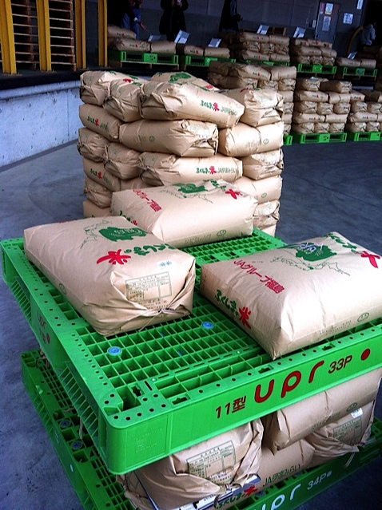
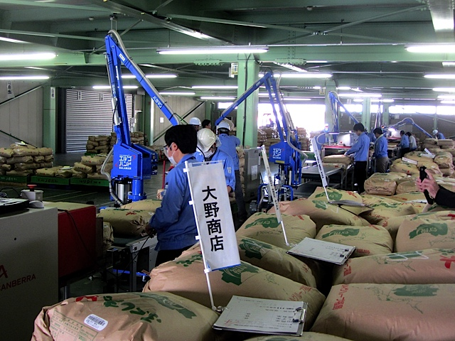
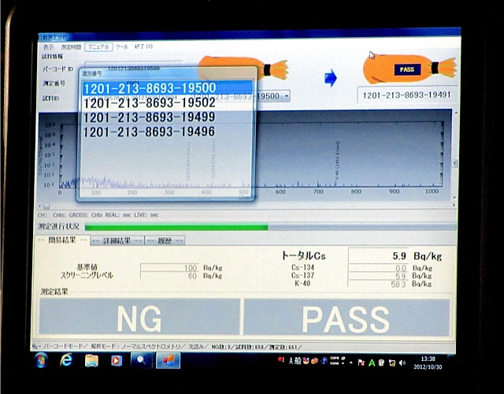
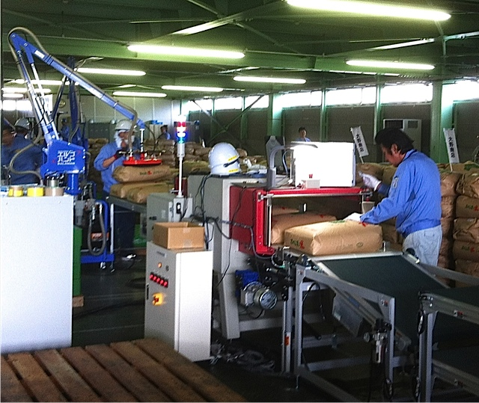
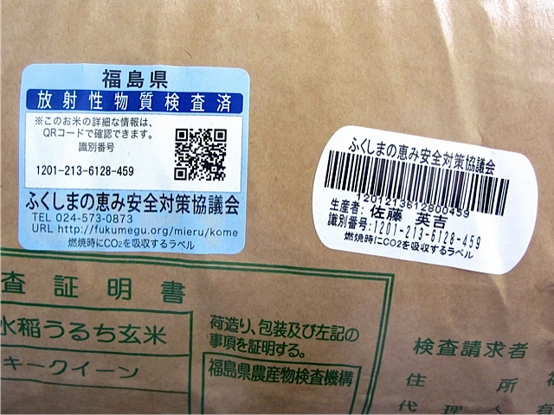
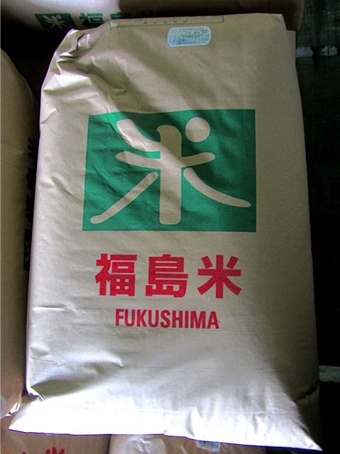
The management of foodstuffs in Date City (October 2012)
26

Slide 27
Concluding remarks (1)
The experience over the last two years in the Fukushima Prefecture shows that the principles and advice of the Commission for post-accident recovery, although perfectible, are globally responding to the challenges of such situations and they find a resonance amongst the authorities, experts, professionals as well as the affected population
It also shows that there are no significant differences between the general feelings and attitudes of the affected populations in Fukushima and in Chernobyl with regard the situation resulting from the two accidents
However, a quarter of century is separating the two accidents and the technical contexts are quite different particularly with the omnipresent role of e-technology and social media
27

Slide 28
Concluding remarks (2)
This new technical context is offering opportunities for consolidating the advice developed so far by ICRP, in cooperation with all those concerned: authorities, experts, professionals and the affected people
However, the rehabilitation of living conditions is not only a matter for science and technology. It is also a human problem calling for respecting the fundamental values of prudence and equity in the management of protection but also respecting the dignity of the affected people and maintaining solidarity with them
Like Chernobyl, the Fukushima experience is demonstrating the prominent role of this human dimension and the duty for the radiation protection community and all relevant experts to consider it with care in the development of their advice and actions
28

Slide 29

www.icrp.org

